Slide 1
Kubernetes on OpenVisus - Why?
Not enough to have Docker containers, you need more control of:
User access
Directory access - Role-Based Access Control (RBAC) to various mounted volumes
Resource access
Docker compose works for local development, but to coordinate many users and many resources, need a more heavy-duty orchestrator
We use Kubernetes (and Docker Swarm) for this task

Slide 2
Kubernetes on OpenVisus - Why?
Environment consistency:
Image tags allow tracking of different software version environments
For example: OpenVisus:1.0.1, OpenVisus:1.2.101
Easy software updates :
to install a new version of a library, simply update Dockerfile, rebuild, push image and re-deploy K8s
installation of new software without root on the remote server (LLNL use PodMan)
Keep up with rapidly-changing software
Expose OpenVisus services to handle BIG datasets

Slide 3
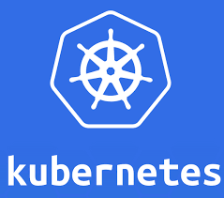
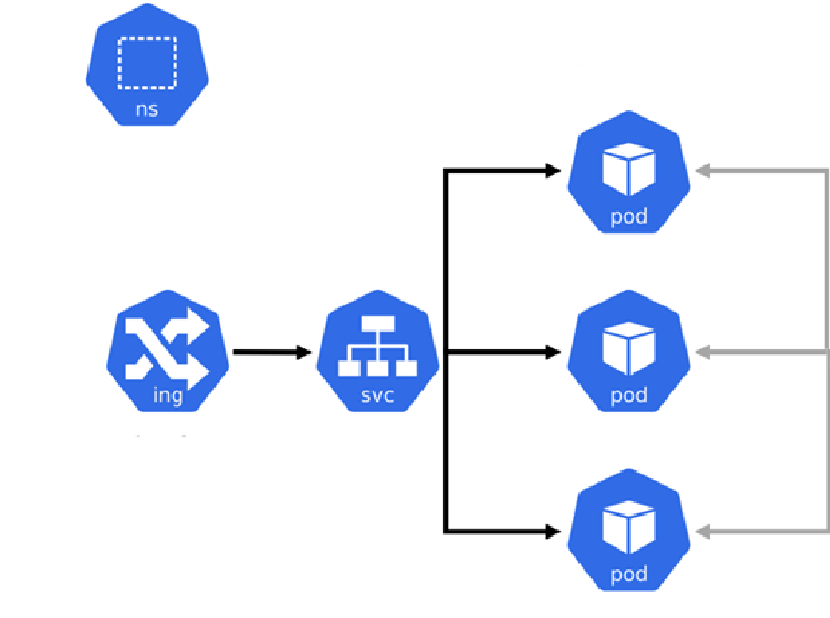
Kubernetes on OpenVisus
Our shared private repo: https://github.com/sci-visus/k8llnl
kubectl create namespace openvisus
deployment and pods
The importance of use an isolated namespace:
multiple virtual clusters backed by the same physical cluster. These virtual clusters are called namespaces.
Namespaces protect resources
Create short-living deployment, try stuff, even break stuff, remove at the end
OpenVisus use-case:
creates a temporary K8s namespace
Run OpenVisus server
Use VisusViewer to access the data
Clear all.
namespace
ingress
service

Slide 4
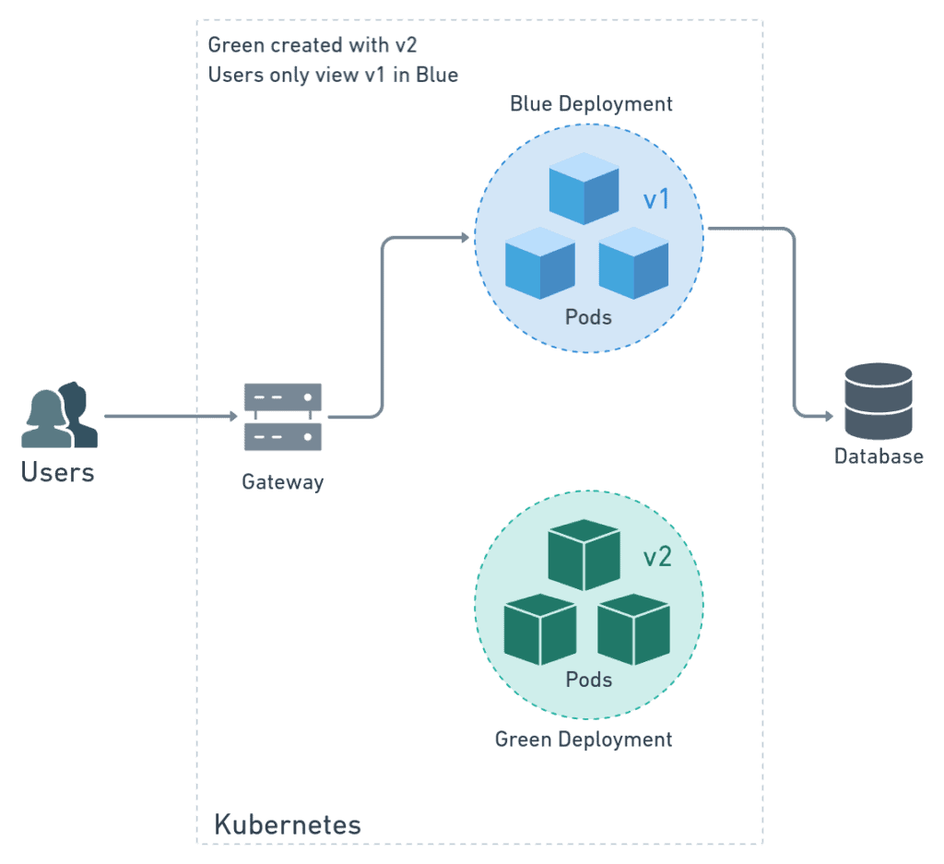
Kubernetes on OpenVisus
kubectl create namespace openvisus
kubectl create deployment --namespace openvisus
mod-visus-deployment
--image=visus/mod_visus:1.2.120
deployment and pods
namespace
ingress
service
The role of K8s deployment:
Very useful for Data Science reproducibility
We deploy a specific version, eventually upgrade and if it does not work, revert to the old version (BLU/GREEN DEPLOYMENT)
Almost zero downtime

Slide 5

Kubernetes on OpenVisus
kubectl create namespace openvisus
kubectl create deployment --namespace openvisus
mod-visus-deployment
--image=visus/mod_visus
kubectl expose deployment --namespace openvisus
mod-visus-deployment --port=80 --target-port=80
--name=mod-visus-service
--type=NodePort
deployment and pods
namespace
ingress
service
The role of the service:
Service is an abstraction to define a logical set of Pods and a policy by which to access them (like micro-services)
K8s gives Pods their own IP addresses and a single DNS name for a set of Pods
Automatic load balancing
Automatic liveness probe and readiness probe

Slide 6

Kubernetes on OpenVisus
kubectl create namespace openvisus
kubectl create deployment --namespace openvisus
mod-visus-deployment
--image=visus/mod_visus
kubectl expose deployment --namespace openvisus
mod-visus-deployment --port=80 --target-port=80
--name=mod-visus-service
--type=NodePort
# create mod-visus ingress (networking.k8s.io/v1beta1)
deployment and pods
namespace
ingress
service
The role of the ingress:
exposes HTTP and HTTPS routes from outside the cluster to services within the cluster.
Solve the problem about SSL certificates delegating to LLNL (Side Car pattern) the security checks

